Slide 1
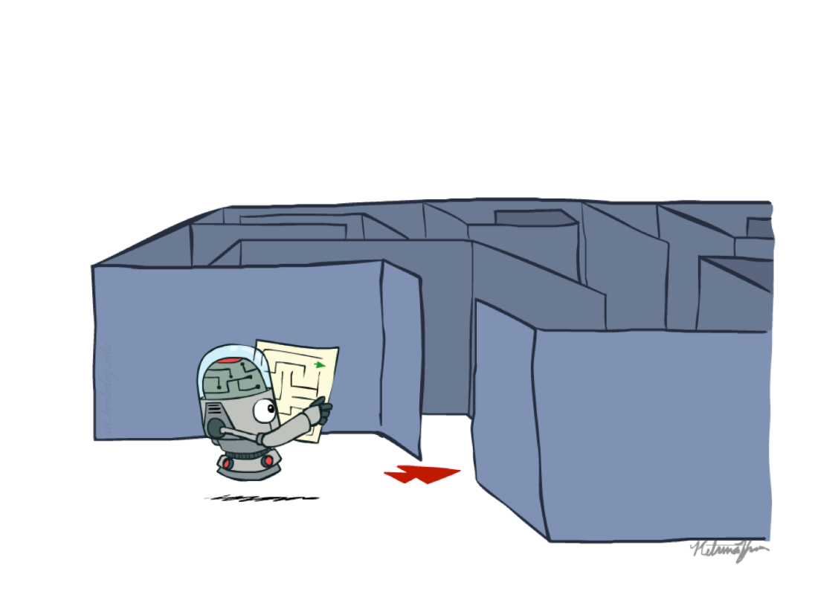
Problem Solving Using Search
Introduction to State Space Search
Instructor: Dr. Mohsin Ashraf
Slide credits: AI BERKELEY

Slide 2
Previous Lecture
Intelligent Agent
Performance measure
Different types of Environments
IA examples based on Environment
Agent types
Simple reflex agents
Reflex agents with state/model
Goal-based agents
Utility-based agents

Slide 3
Introduction
Suppose an agent can execute several actions immediately in a given state
It doesn’t know the utility of these actions
Then, for each action, it can execute a sequence of actions until it reaches the goal
The immediate action which has the best sequence (according to the performance measure) is then the solution
Finding this sequence of actions is called search, and the agent which does this is called the problem-solver.
Its possible that some sequence might fail, e.g., getting stuck in an infinite loop, or unable to find the goal at all.

Slide 4
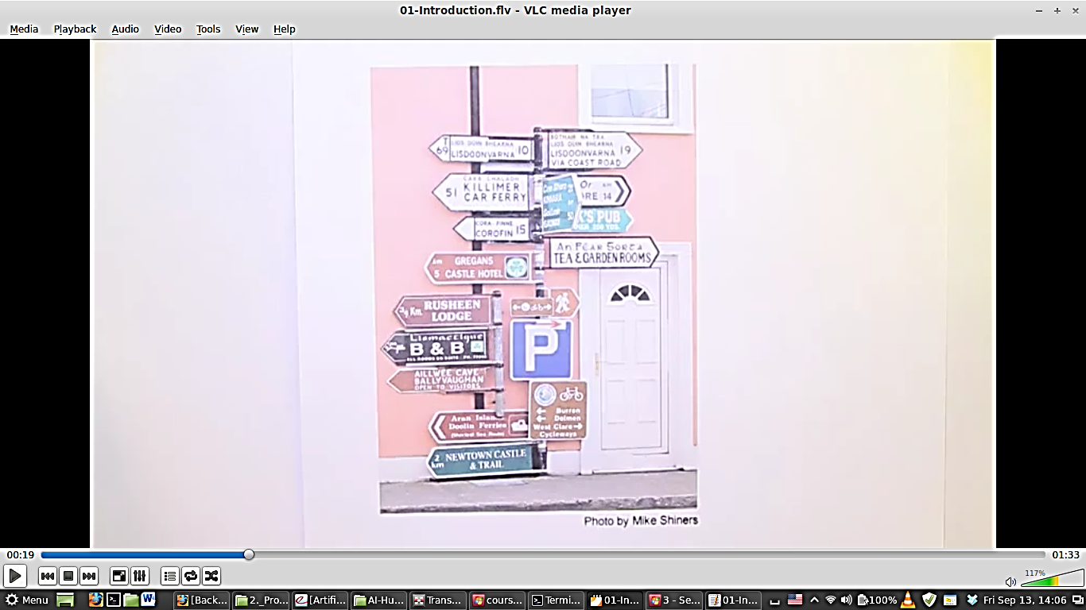
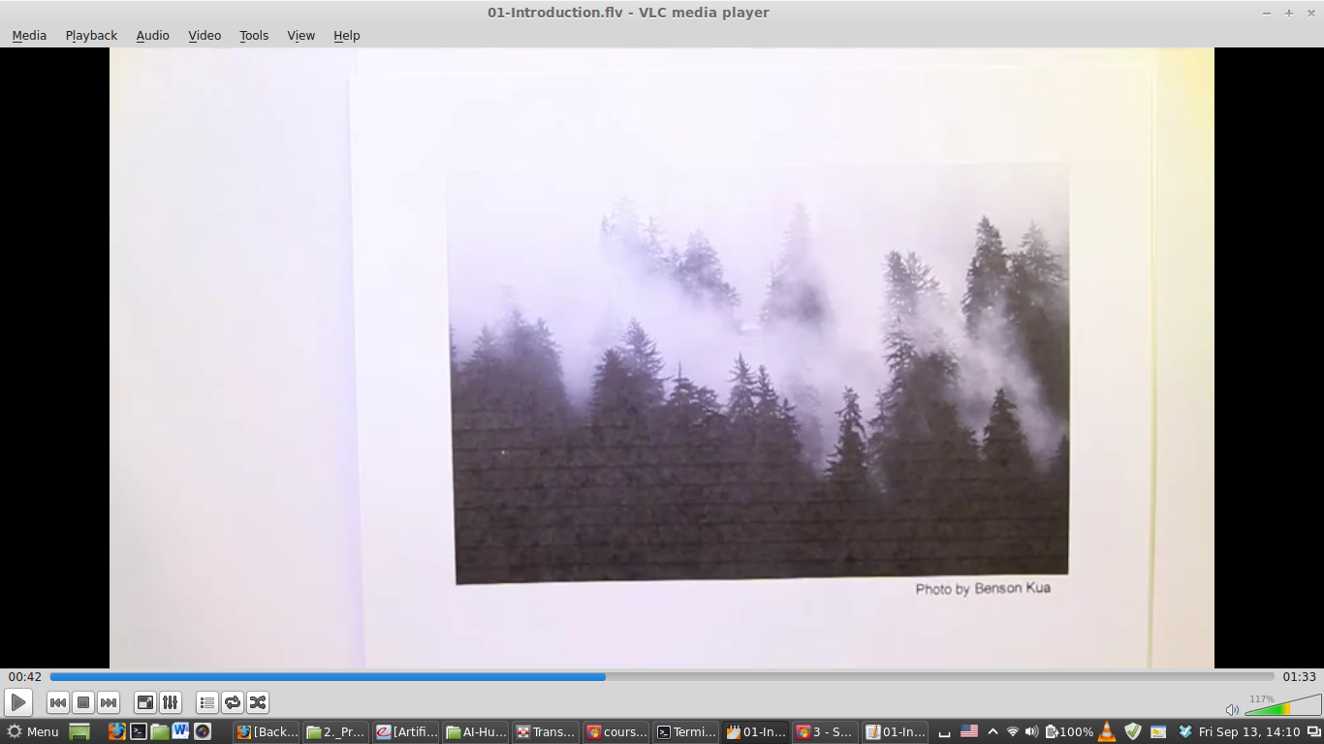

Slide 5
Problem-Solving Agent
Problem solving agent is a goal-based agent that decides what to do by systematically finding sequences of actions that lead to desirable states (goal)
Many problems can be represented as a set of states and a set of rules of how one state is transformed to another.

Slide 6
Examples
Getting from home to UCP
START: home location
GOAL: UCP FIT Department.
OPERATORS: move one block, turn
Loading a moving truck
START: apartment full of boxes and furniture
GOAL: empty apartment, all boxes and furniture in the truck
OPERATORS: select item, carry item from apartment to truck, load item
Getting settled
START: items randomly distributed over the place
GOAL: satisfactory arrangement of items
OPERATORS: select item, move item

Slide 7
Example Problems
Toy Problems
vacuum world
8-puzzle
8-queens
cryptarithmetic
vacuum agent
missionaries and cannibals
Real-world Problems
route finding
touring problems
traveling salesperson
VLSI layout
robot navigation
assembly sequencing
Web search

Slide 8
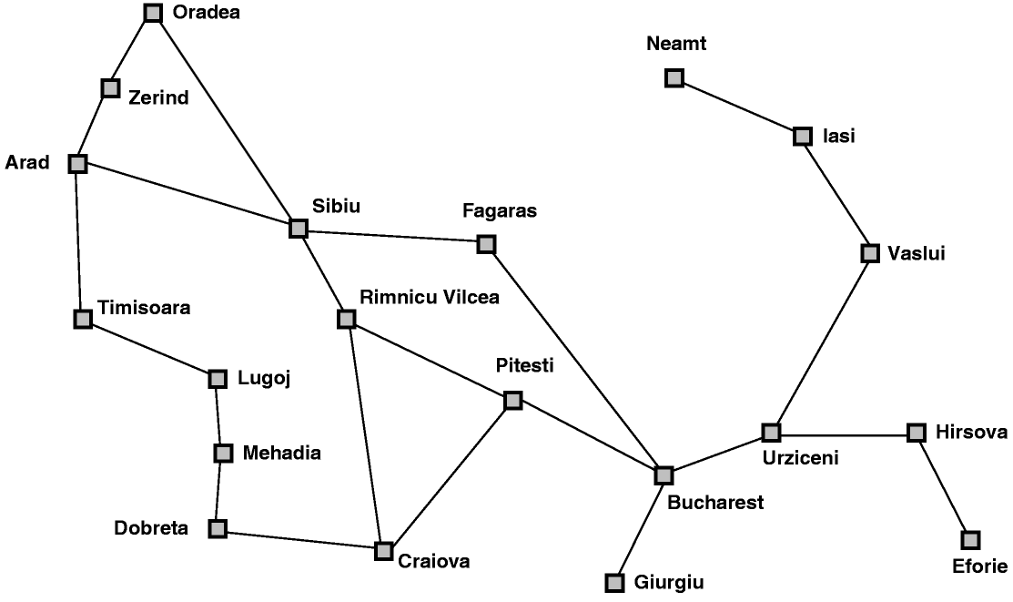
Classical AI Search Problem
Touring Agent Problem (Map Search / Navigation)

Slide 9
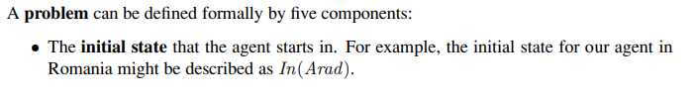

Slide 10
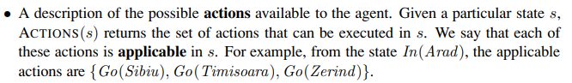

Slide 11
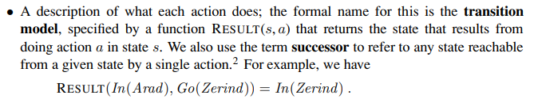

Slide 12
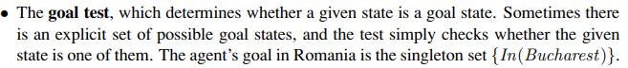

Slide 13
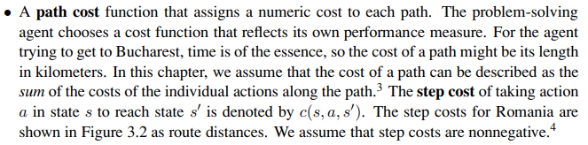

Slide 14
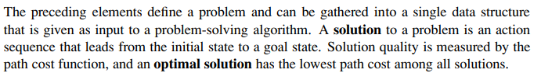

Slide 15
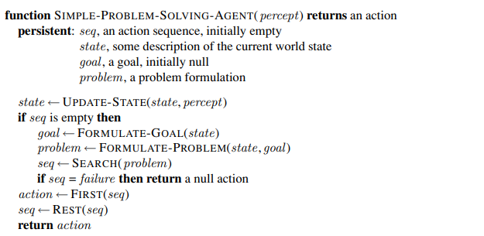
Structure of Problem solving agent

Slide 16
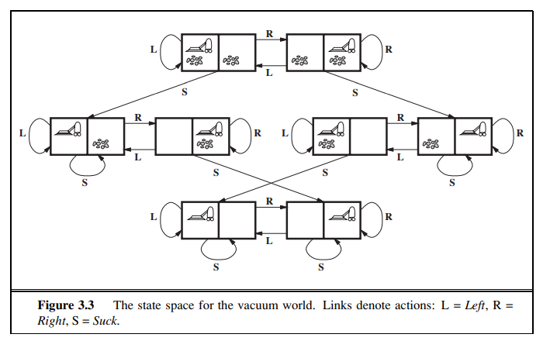
Toy Example-1

Slide 17
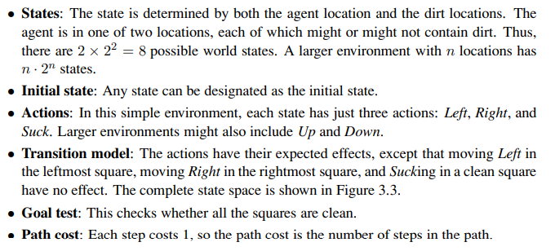

Slide 18
Classical AI Search Problem
8-Puzzle
2
1
3
1
2
3
4
7
6
4
5
6
5
8
7
8

Slide 19
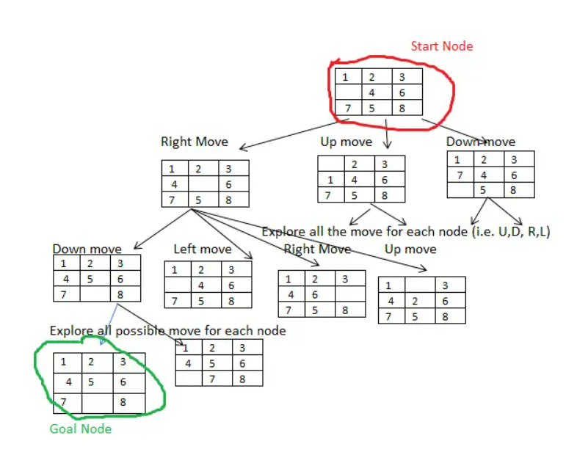

Slide 20
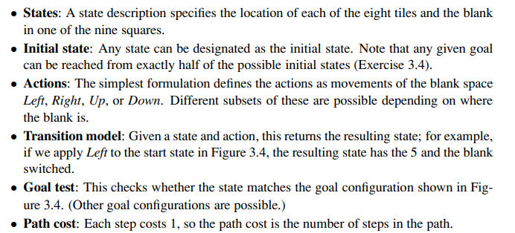

Slide 21
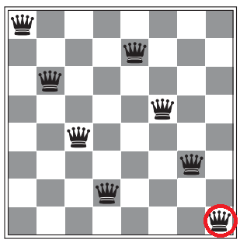
8 Queen Problem

Slide 22
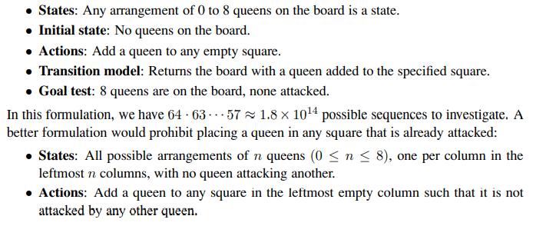

Slide 23
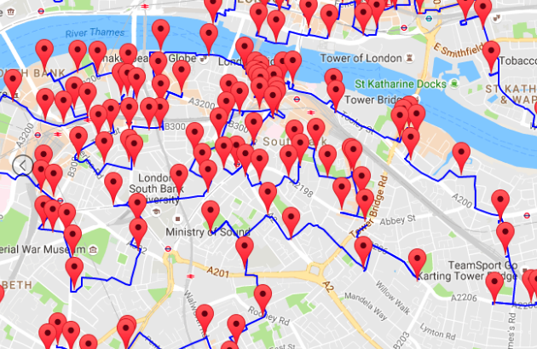
Classical AI Search Problem
Travelling Salesperson Problem (TSP)
Suppose a salesman has five cities to visit and then must return home.
The goal of the problem is to find the shortest path for salesman to travel, visiting each city, and then returning to the starting city.

Slide 24
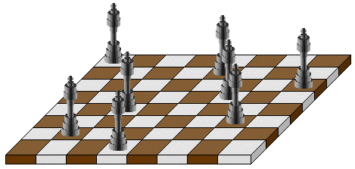
Classical AI Search Problem
N-Queens
Problem of placing n chess queens on an n×n chessboard so that no two queens attack each other
A solution requires that no two queens share the same row, column, or diagonal

Slide 25
Classic AI Search Problems
5-Queens:
1
2
3
4
5
1
2
3
4
5

Slide 26
Classic AI Search Problems
5-Queens:
1
2
3
4
5
1
2
3
4
5

Slide 27
Classic AI Search Problems
5-Queens:
1
2
3
4
5
1
2
3
4
5

Slide 28
Classic AI Search Problems
5-Queens:
1
2
3
4
5
1
2
3
4
5

Slide 29
Classic AI Search Problems
5-Queens:
1
2
3
4
5
1
2
3
4
5

Slide 30
Classic AI Search Problems
5-Queens:
1
2
3
4
5
1
2
Solution !!
No Queen is under Attack
3
4
5

Slide 31
River Crossing Problem
A farmer wishes to carry a wolf, a duck and corn across a river, from the south to the north shore.
The farmer has a small rowing boat.
The boat can only carry at most the farmer and one other item.
If left unattended the wolf will eat the duck and the duck will eat the corn.
How can the farmer safely transport the wolf, the duck and the corn to the opposite shore?

Slide 32



Missionaries and cannibals
Three missionaries and three cannibals are on the left bank of a river.
There is one boat which can hold one or two people.
Find a way to get everyone to the right bank, without ever leaving a group of missionaries in one place outnumbered by cannibals in that place.
Initial State
Goal State

Slide 33

Problem Solving by Searching
Problem Formulation

Slide 34
Search in AI
Search in Data Structures
You’re given an existent tree.
You search it in different orders.
It resides in memory.
Search in Artificial Intelligence
The tree does not exist.
You have to generate it as you go.
For realistic problems, it does not fit in memory.

Slide 35
Problem Formulation
A Problem Space consists of
The current state of the world (initial state)
A description of the actions we can take to transform one state of the world into another (operators or successor function).
A description of the desired state of the world (goal state), this could be implicit or explicit.
A solution consists of the goal state, or a path to the goal state.

Slide 36
Problem Formulation
Initial state
Actions (operators, successor functions)
State space
Path
Goal test
Solution
Path cost
Total cost

Slide 37
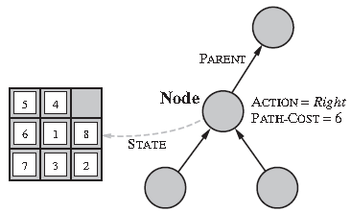
Representation of a Search/State Space
A convenient way of representing search spaces is as a graph
States are nodes
Actions are edges
Initial state is root
Solution is path from root to goal node
Edges sometimes have associated costs
States resulting from operator are children

Slide 38







State Space Representation
A search problem consists of:
A state space
A successor function
(with actions, costs)
A start state and a goal test
A solution is a sequence of actions (a plan) which transforms the start state to a goal state
“N”, 1.0
“E”, 1.0
Notes:
Often comes back on exams
Goal test – sometimes more than one state that satisfies having achieved the goal, for example, “eat all the dots”
Abstraction

Slide 39
State Space Graphs
State space graph: A mathematical representation of a search problem
Nodes are (abstracted) world configurations
Arcs represent successors (action results)
The goal test is a set of goal nodes (maybe only one)
In a state space graph, each state occurs only once!
We can rarely build this full graph in memory (it’s too big), but it’s a useful idea
a
G
b
c
d
e
f
S
h
p
q
r
Tiny search graph for a tiny search problem

Slide 40
Search Trees
This is now / start
“N”, 1.0
“E”, 1.0
Possible futures
A search tree:
A “what if” tree of plans and their outcomes
The start state is the root node
Children correspond to successors
Nodes show states, but correspond to PLANS that achieve those states
For most problems, we can never actually build the whole tree
Notes:
Different plans that achieve the same state, will be different nodes in the tree.

Slide 41
State Space Graphs vs. Search Trees
State Space Graph
Each NODE in the search tree is an entire PATH in the state space graph.
Search Tree
S
a
G
d
e
p
b
c
q
b
c
e
h
r
d
e
f
a
a
h
r
p
q
f
S
h
We construct both on demand – and we construct as little as possible.
p
q
f
q
c
G
p
q
r
q
c
G
a
a

Slide 42
Approach
Start with a frontier that contains the initial state.
Repeat:
If the frontier is empty, then no solution.
Remove a node from the frontier.
If node contains goal state, return the solution.
Expand node, add resulting nodes to the frontier.

Slide 43

Quiz: State Space Graphs vs. Search Trees
Consider this 4-state graph:
How big is its search tree (from S)?
a
S
G
b
Important: Lots of repeated structure in the search tree!

Slide 44
Quiz: State Space Graphs vs. Search Trees
Consider this 4-state graph:
How big is its search tree (from S)?
a
s
a
b
S
G
b
G
a
G
b
a
G
b
G
…
…
Important: Lots of repeated structure in the search tree!

Slide 45
Revised Approach
Start with a frontier that contains the initial state.
Start with an empty explored set.
Repeat:
If the frontier is empty, then no solution.
Remove a node from the frontier.
If node contains goal state, return the solution.
Add the node to the explored set.
Expand node, add resulting nodes to the frontier if they aren't already in the frontier or the explored set.

Slide 46
Searching with a Search Tree
Search:
(1) Expand out potential plans (tree nodes)
(2) Maintain fringe (peripheral) partial plans under consideration.
(3) Try to expand as few tree nodes as possible

Slide 47

Example: Romania

Slide 48
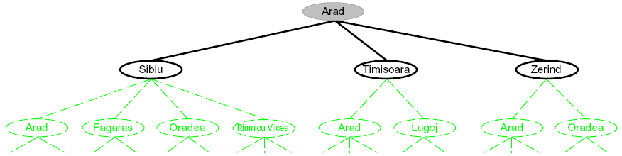
Searching with a Search Tree
Search:
Expand out potential plans (tree nodes)
Maintain a fringe of partial plans under consideration
Try to expand as few tree nodes as possible

Slide 49
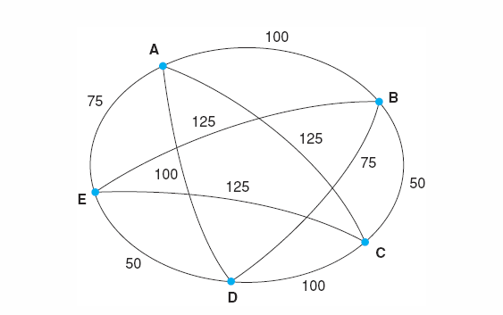
Problem Formulation: TSP
Travelling Salesperson Problem (TSP)
Suppose a salesman has five cities to visit and then must return home.
The goal of the problem is to find the shortest path for salesman to travel, visiting each city, and then returning to the starting city.

Slide 50
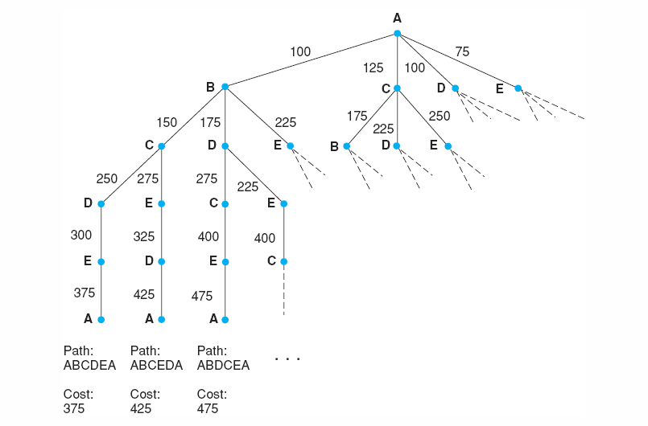
Search for the travelling salesperson problem. Each arc is marked with the total weight of all paths from the start node (A) to its endpoint.
Luger: Artificial Intelligence, 6th edition. © Pearson Education Limited, 2009

Slide 51
Problem Formulation: 8-Puzzle Problem
Initial State
Operators
Goal State
2
1
3
Slide blank square left.
Slide blank square right.
….
1
2
3
4
7
6
4
5
6
5
8
7
8

Slide 52
Problem Formulation: 8-Puzzle Problem
Representing states:
For the 8-puzzle
3 by 3 array
5, 6, 7
8, 4, BLANK
3, 1, 2
A vector of length nine
5, 6, 7, 8, 4, BLANK, 3, 1, 2
A list of facts
Upper_left = 5
Upper_middle = 6
Upper_right = 7
Middle_left = 8
5
6
7
8
4
3
1
2

Slide 53
Problem Formulation: 8-Puzzle Problem
Specifying operators
There are often many ways to specify the operators, some will be much easier to implement...
Move 1 left
Move 1 right
Move 1 up
Move 1 down
Move 2 left
Move 2 right
Move 2 up
Move 2 down
Move 3 left
Move 3 right
Move 3 up
Move 3 down
Move 4 left
…
5
6
7
Move Blank left
Move Blank right
Move Blank up
Move Blank down
8
4
3
1
2

Slide 54

Problem Formulation: 8-Puzzle Problem
states locations of tiles
actions move blank left, right, up, down
goal test goal state (given)
path cost 1 per move

Slide 55
Problem Formulation: 8-Puzzle Problem
1
2
3
1
2
3
Operators: slide blank up, slide blank down, slide blank left, slide blank right
Solution: swap-down, swap-left, swap-up, swap-right, swap-down
Path cost: 5 steps to reach the goal
4
8
4
5
6
7
6
5
7
8
Initial state
Goal state
1
2
3
1
2
3
1
2
3
1
2
3
1
2
3
1
2
3
4
8
4
8
5
4
8
5
4
5
4
5
4
5
6
7
6
5
7
6
7
6
7
8
6
7
8
6
7
8

Slide 56
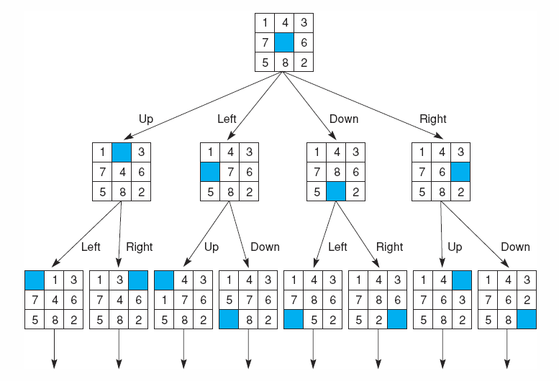
State space of the 8-puzzle generated by “move blank” operations
Notes:
Insert fig 3.8

Slide 57
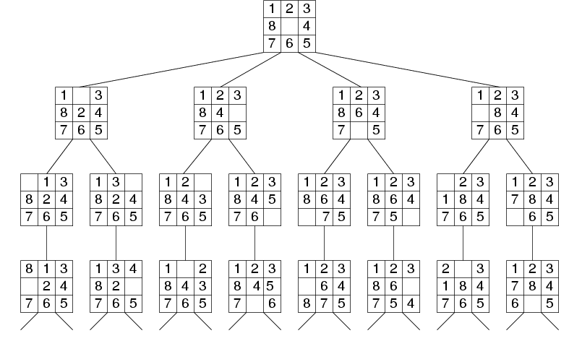
Fragment of 8-Puzzle Problem Space

Slide 58

Problem Formulation: Missionaries and Cannibals
Three missionaries and three cannibals are on the left bank of a river.
There is one boat which can hold one or two people.
Find a way to get everyone to the right bank, without ever leaving a group of missionaries in one place outnumbered by cannibals in that place.

Slide 59
Missionaries and cannibals
States: three numbers (i, j, k) representing the number of missionaries, cannibals, and boats on the left bank of the river.
Initial state: (3, 3, 1)
Operators: take one missionary, one cannibal, two missionaries, two cannibals, one missionary and one cannibal across the river in a given direction
Goal Test: reached state (0, 0, 0)?
Path Cost: Number of crossings.

Slide 60
Formalization of the M&C Problem
State space: triple (x,y,z), where x,y, and z represent the number of missionaries, cannibals and boats currently on the original bank.
Initial State: (3,3,1)
Successor function: From each state, either bring one missionary, one cannibal, two missionaries, two cannibals, or one of each type to the other bank.
Note: Not all states are attainable (e.g., (0,0,1)), and some are illegal.
Goal State: (0,0,0)
Path Costs: 1 unit per crossing

Slide 61
Missionaries and Cannibals
Solution = the sequence of actions within the path :
[(3,3,1)→ (2,2,0)→(3,2,1) →(3,0,0) →(3,1,1) →(1,1,0) →(2,2,1) →(0,2,0) →(0,3,1) →(0,1,0) → (0,2,1) →(0,0,0)]
Cost = 11 crossings

Slide 62
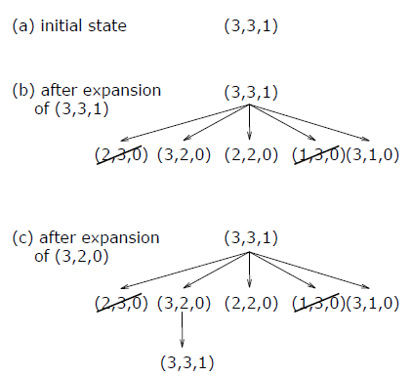
Missionaries and Cannibals
From the initial state, produce all successive states step by step 􀃆search tree.

Slide 63
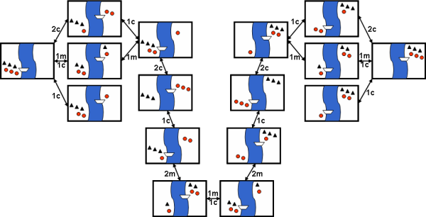
Missionaries and Cannibals
Search-space for the Missionaries and Cannibals problem

Slide 64
The River Problem
A farmer wishes to carry a wolf, a duck and corn across a river, from the south to the north shore. The farmer has a small rowing boat. The boat can only carry at most the farmer and one other item.
If left unattended the wolf will eat the duck and the duck will eat the corn.
How can the farmer safely transport the wolf, the duck and the corn to the opposite shore?
Farmer, Wolf,
Duck and Corn
River
River
boat
boat
Farmer, Wolf,
Duck and Corn

Slide 65
The River Problem
The River Problem:
F=Farmer W=Wolf D=Duck C=Corn /=River
How can the farmer safely transport the wolf, the duck and the corn to the opposite shore?
-/FWCD
FWCD/-

Slide 66
The River Problem
Problem formulation:
State representation: location of farmer and items in both sides of river
[items in South shore / items in North shore] : (FWDC/-, FD/WC, C/FWD …)
Initial State: farmer, wolf, duck and corn in the south shore FWDC/-
Goal State: farmer, duck and corn in the north shore -/FWDC
Operators: the farmer takes in the boat at most one item from one side to the other side
(F-Takes-W, F-Takes-D, F-Takes-C, F-Takes-Self [himself only])
Path cost: the number of crossings

Slide 67
The River Problem
Problem solution: (path Cost = 7)
While there are other possibilities here is one 7 step solution to the river problem
F
D
D
F
W
D
F-Takes-D
F-Takes-F
F-Takes-W
F
W
D
C
W
C
F
W
C
C
Initial State
WC/FD
FWC/D
C/FWD
F-Takes-D
F
W
D
C
W
C
F
W
C
W
F-Takes-D
F-Takes-F
F-Takes-C
F
D
D
F
D
C
Goal State
FD/WC
D/FWC
FDC/W

Slide 68
Summary
Search: process of constructing sequences of actions that achieve a goal given a problem.
It is assumed that the environment is observable, deterministic, static and completely known.
Goal formulation is the first step in solving problems by searching. It facilitates problem formulation.
Formulating a problem requires specifying five components:
State representation,
Initial state,
Goal state,
Operators (actions), and
Path cost function.

Slide 69
Search Strategies (Next Lecture)
Several general-purpose search algorithms that can be used to solve these problems.
Uninformed search algorithms
algorithms that are given no information about the problem other than its definition
Although some of these algorithms can solve any solvable problem, none of them can do so efficiently
Informed search algorithms
can do quite well given some guidance on where to look for solutions

Slide 70
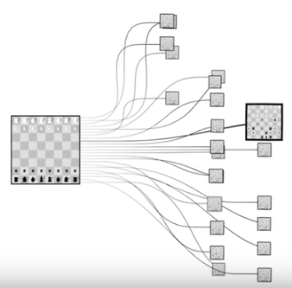

Slide 71


Slide 72
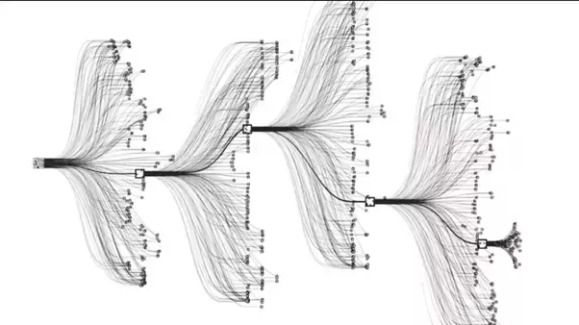

Slide 73
